Slide 1

Real-time early stress identification in plant using deep learning implementation in fpga
Krit Rojanarungruengporn
Student ID : 6070419521
Advisor : Asst. Prof. Suree Pumrin
Faculty of Electrical Engineering
Chulalongkorn University
2018

Slide 2

The Great Balancing Act: 3 Needs for a Sustainable Food Future. (n.d.). Retrieved from https://www.wri.org/resources/presentations/great-balancing-act-3-needs-sustainable-food-future

Slide 3
Promising solution
With
Increase
Disease resistance
Yield Higher Quality
Phenotype and Genotype Relationship
Next Generation DNA Sequencing
Can be found from
Problem :
Labor intensive
Required skilled labor
Time consuming operation
High cost
Breed Selection
Plant Phenotyping

Slide 4
The Advent of technology
Imaging Sensor
Computer Vision
Machine Learning
(Deep Learning)
High-Throughput automatic plant phenotyping
Automatic early stress detection
Lower cost of operation
New insight
More sustainable operation
Environmental Controlled technology
UAV
Hyperspectral Imager

Slide 5
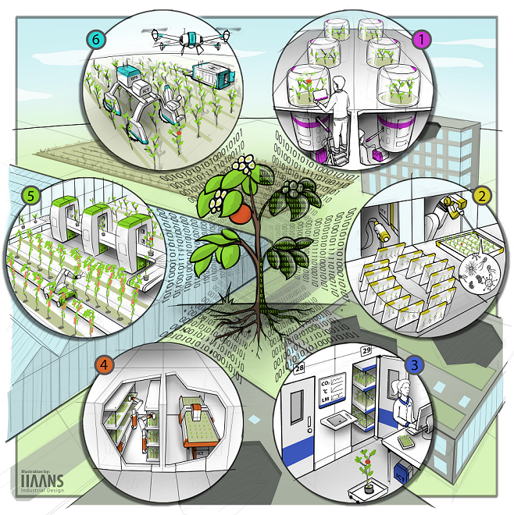
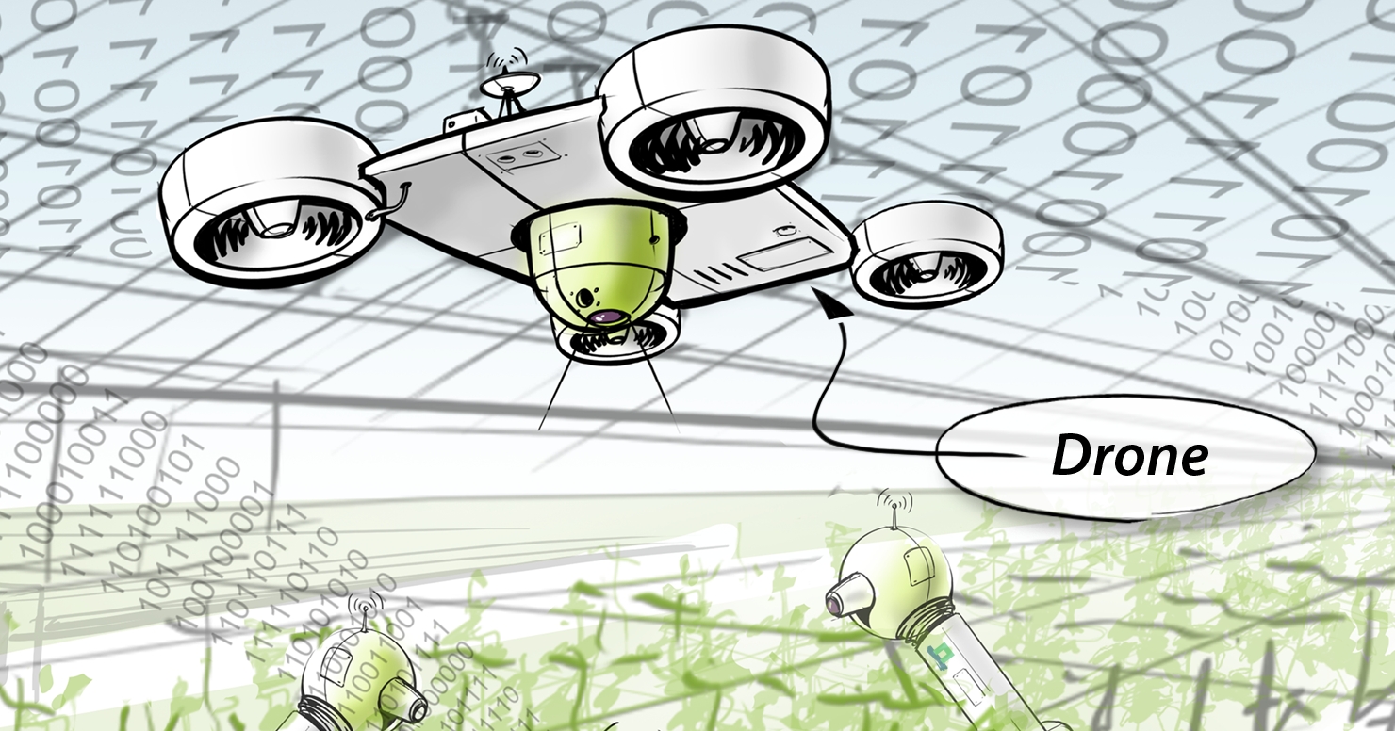
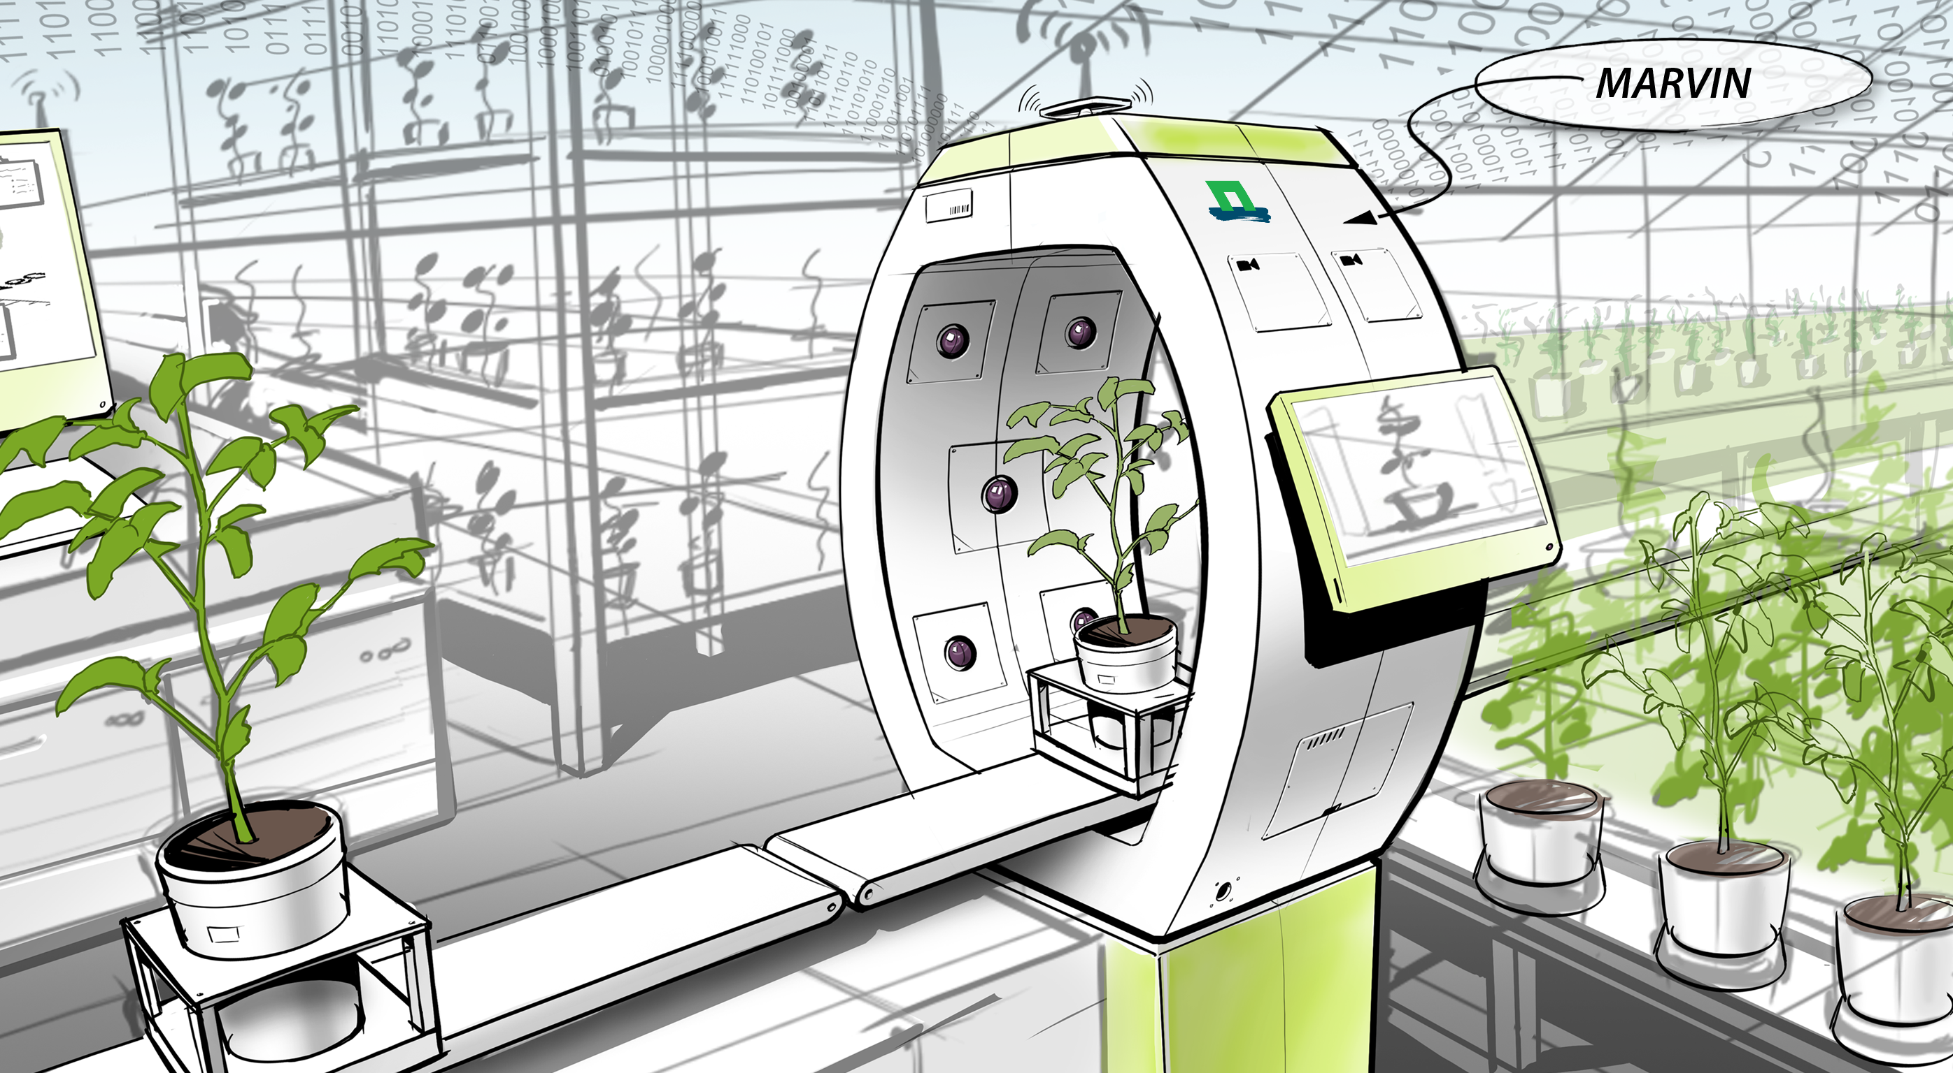
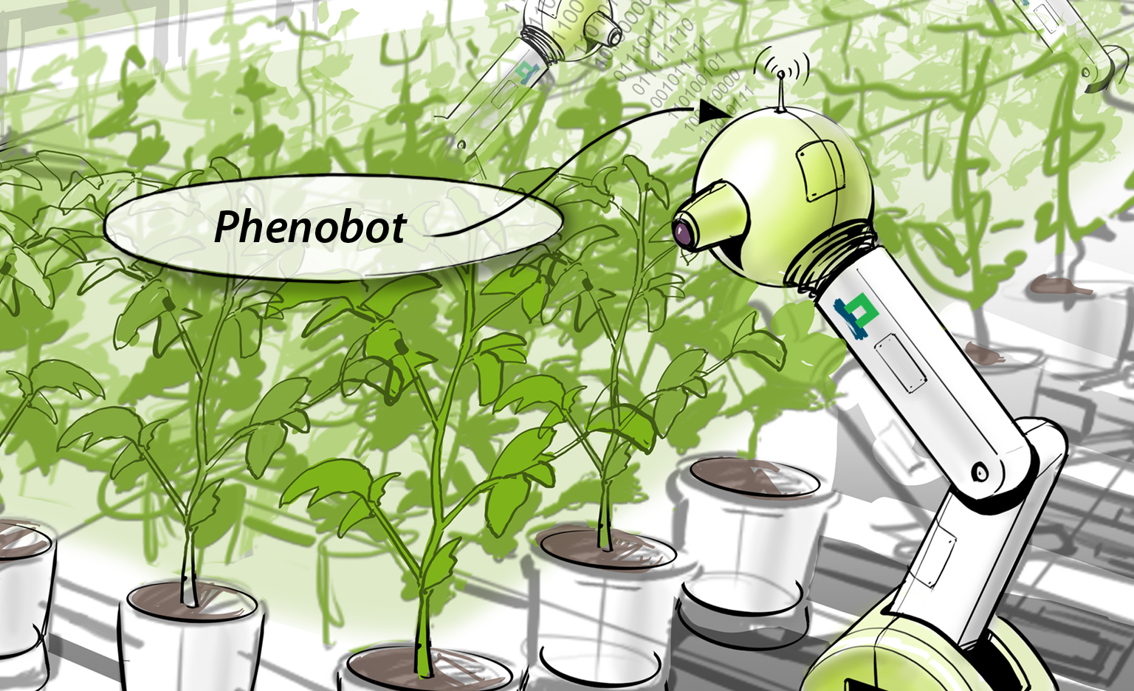
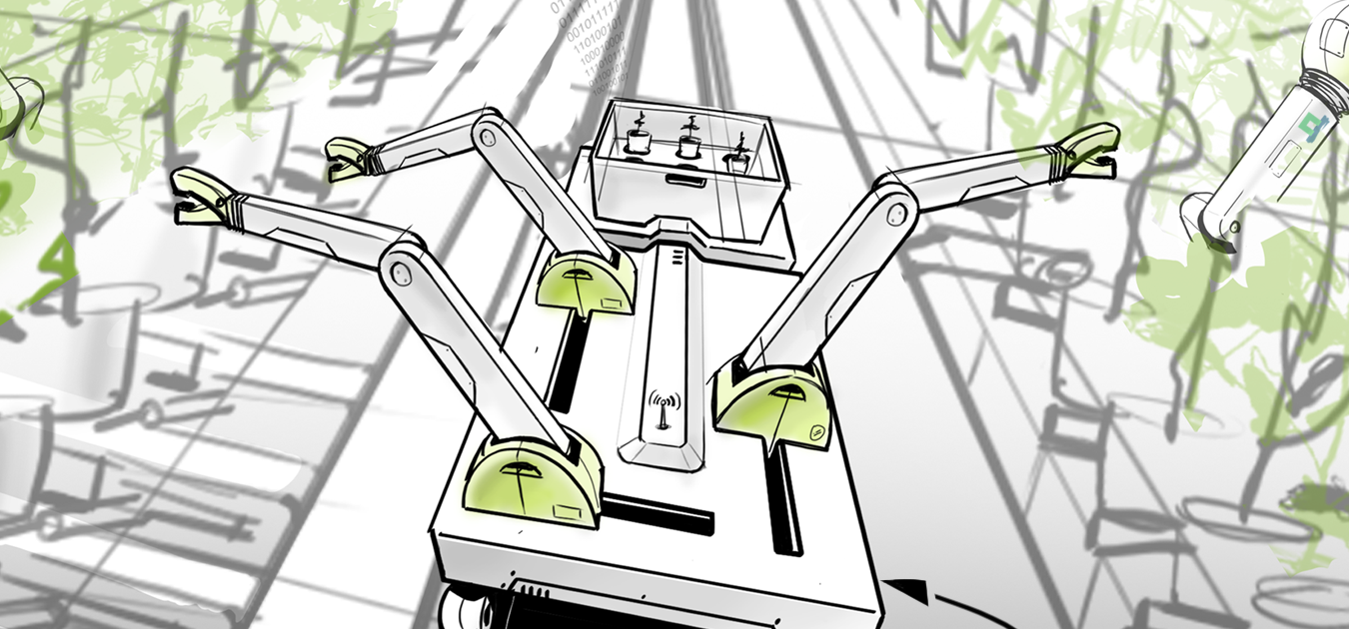
What is Plant Phenotyping
Plant phenotyping refers to a quantitative description of the plant’s anatomical, ontogenetical, physiological and biochemical properties
High-throughput plant phenotyping refers to the characterization of the whole cascade of changes happening after DNA is transcribed into RNA (transcriptomics) leading to the formation of proteins (proteomics).
Summer School on Image Analysis for Plant Phenotyping. (n.d.). Retrieved from https://www.wur.nl/en/activity/Summer-School-on-Image-Analysis-for-Plant-Phenotyping-.htm

Slide 6
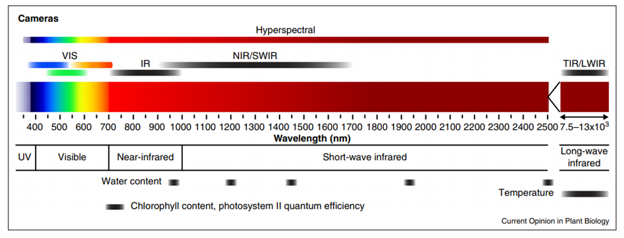
Imaging for plant phenotyping
Fahlgren, N., M.A. Gehan, and I. Baxter, Lights, camera, action: high-throughput plant phenotyping is ready for a close-up. Current Opinion in Plant Biology, 2015. 24: p. 93-99.
Wave Length | Phenotyping Parameter
VIS (400-700 nm) | Leaf area, Biomass, Grow rate, Stress detection etc.
NIR/SWIR | Water content, Leaf Thickness, Stress detection etc.
TIR/LWIR | Thermal Imaging, Salinity Stress
Chlorophyll Fluorescence | Chlorophyll content, Photosynthesis Efficiency
Hyperspectrum | All most everything depend on the range of Hyperspectral imager

Slide 7
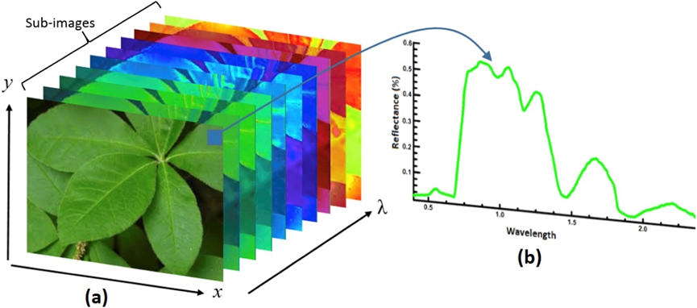
Hyperspectral imaging
Very promising for high-throughput plant phenotyping, but required:
High computational power
Real-time operation
Low power consumption in case using with UAV
Limitation :
High cost of hardware
Mishra, P., et al., Close range hyperspectral imaging of plants: A review. Biosystems Engineering, 2017. 164: p. 49-67.

Slide 8
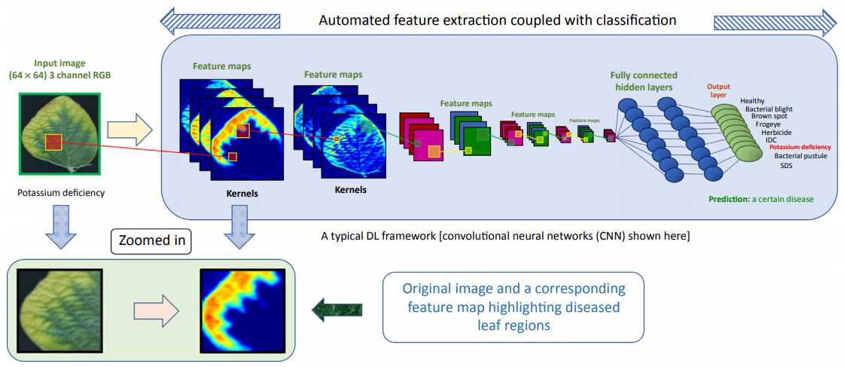
Early Stress Detection
Early stress detection is one of the outcome application of plant phenotyping. It can reduce the lost by telling the grower about the abnormal state of the plant. The system also reduce the cost of the labor used for monitoring.
Deep learning is one of the most popular tool
using for plant stress detection
Singh, A.K., et al., Deep Learning for Plant Stress Phenotyping: Trends and Future Perspectives. Trends in Plant Science, 2018. 23(10): p. 883-898.

Slide 9
Thesis Objective
Develop VIS (Visible light spectrum) plant phenotyping system which can detect early stress in plant and send an alarm to the grower with the optional phenotyping parameters of leaf area, leaf count and grow rate, by using computer vision and convolution neural network on FPGA implementation.

Slide 10
Scope
System will get the input from imaging sensor in the form of video stream, detect the leaves of the plant, measure leaf area , grow rate and leaf count. It will send notification to the grower if it can detect stress of the plant.

Slide 11
Benefits
Automatic plant phenotyping system
Early stress detection system
Can be use as a starting point for development of hyperspectral imaging plant phenotyping system.

Slide 12
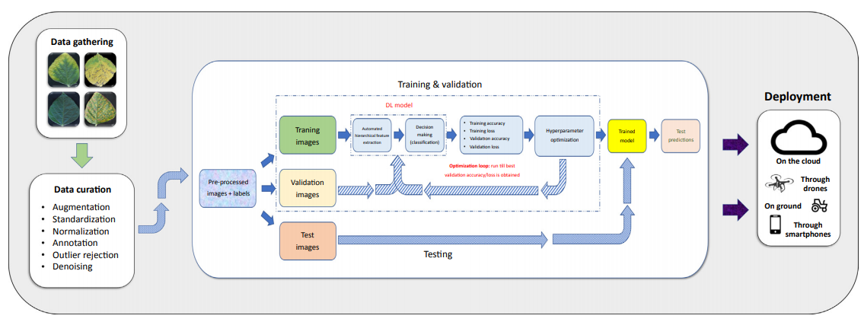
Deep learning freamwork
Singh, A.K., et al., Deep Learning for Plant Stress Phenotyping: Trends and Future Perspectives. Trends in Plant Science, 2018. 23(10): p. 883-898.

Slide 13
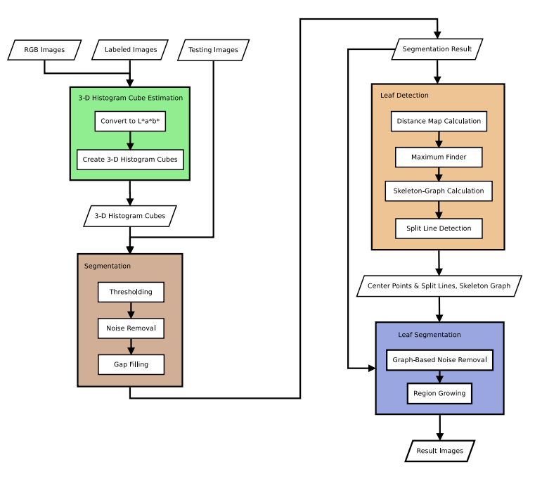
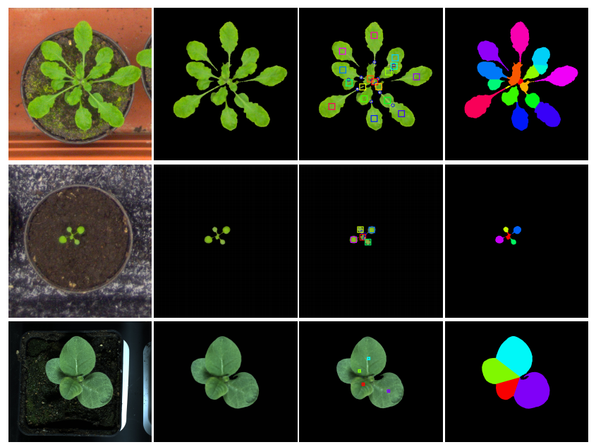
3-D Histogram-Based Segmentation and Leaf Detection
Pape, J.-M. and C. Klukas, 3-D Histogram-Based Segmentation and Leaf Detection for Rosette Plants. 2014. 61-74.

Slide 14
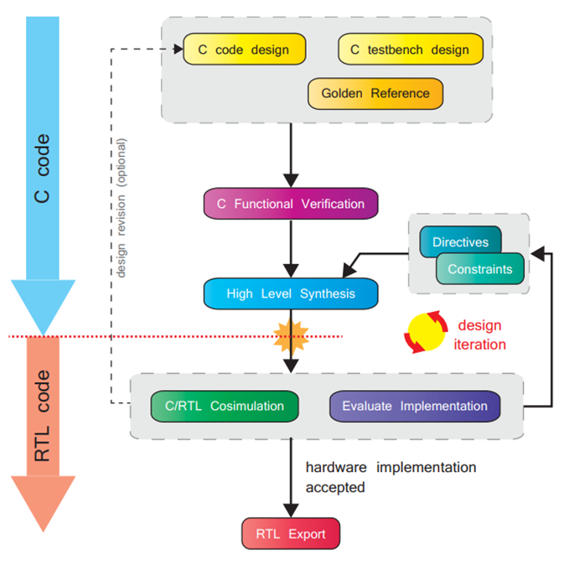
FPGA implementation with vivado hls
Crockett, L. H., Elliot, R. A., & Enderwitz, M. A. (2014). The Zynq Book Embedded Processing with the Arm Cortex-A9 on the Xilinx Zynq-7000 All Programmable Soc. Glasgow: Strathclyde Academic Media.

Slide 15
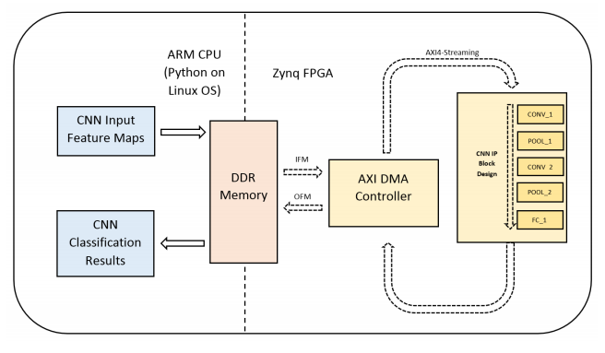
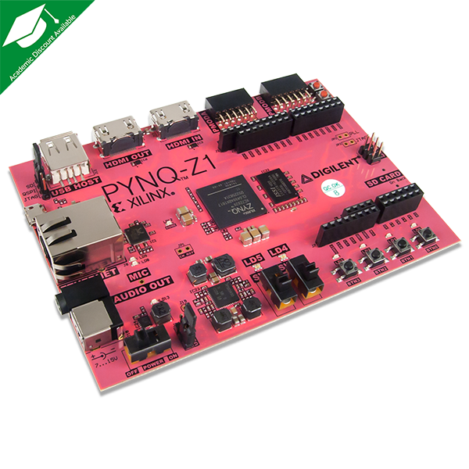
Implement CNN On fpga using pynq platform
Wang, E., J.J. Davis, and P.Y.K. Cheung. A PYNQ-Based Framework for Rapid CNN Prototyping. IEEE.

Slide 16
Experimentation
CNN and FPGA Implementation testing
Leaf Segmentation and plant phenotyping
As an input for CNN training dataset
Train handwritten digit recognition CNN model using MNIST dataset
Implement the model on PYNQ-Z1
Evaluate result
Collect image dataset for stress detection of Thai rice plant
Train new CNN model with Thai rice dataset for stress classification
Test run on PYNQ
Testing the system in real growing site
Train CNN model for stress detection
FPGA Implementation on PYNQ planform

Slide 17
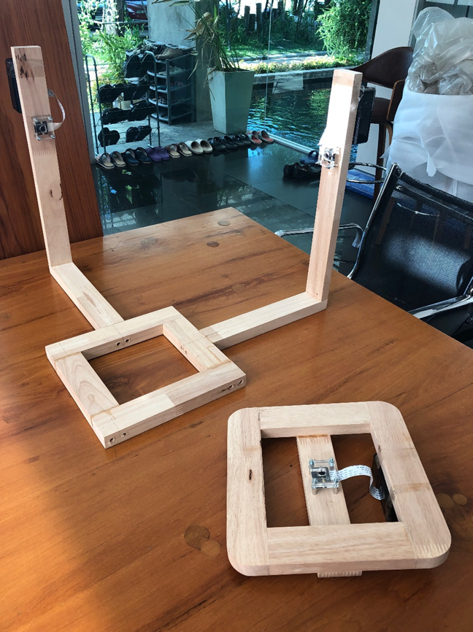
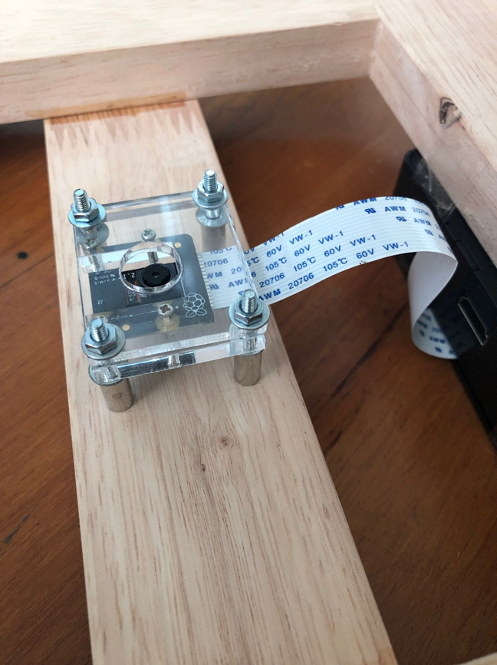
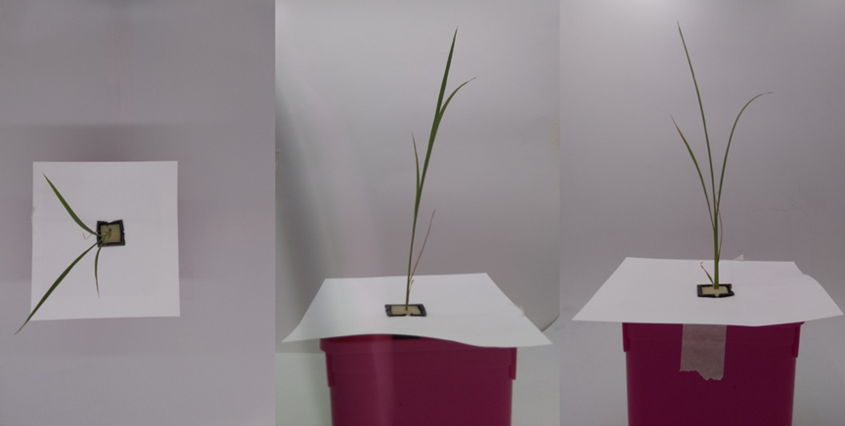
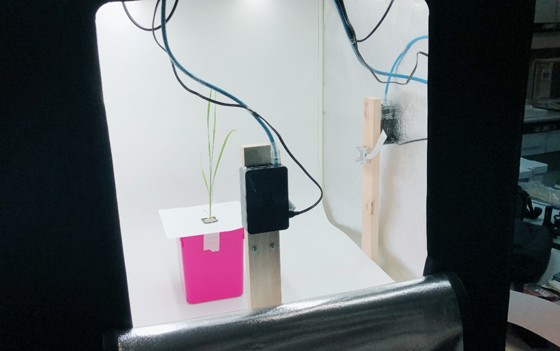
Collect thai rice plant dataset
Dataset is collected from PhD student’s research of botanic faculty of Chulalongkorn university.
Dataset is the images of 16 days rice plant treated with the vary nutrition concentration to observe nutrition deficit status.
The image is taking simultaneously in three views.

Slide 18
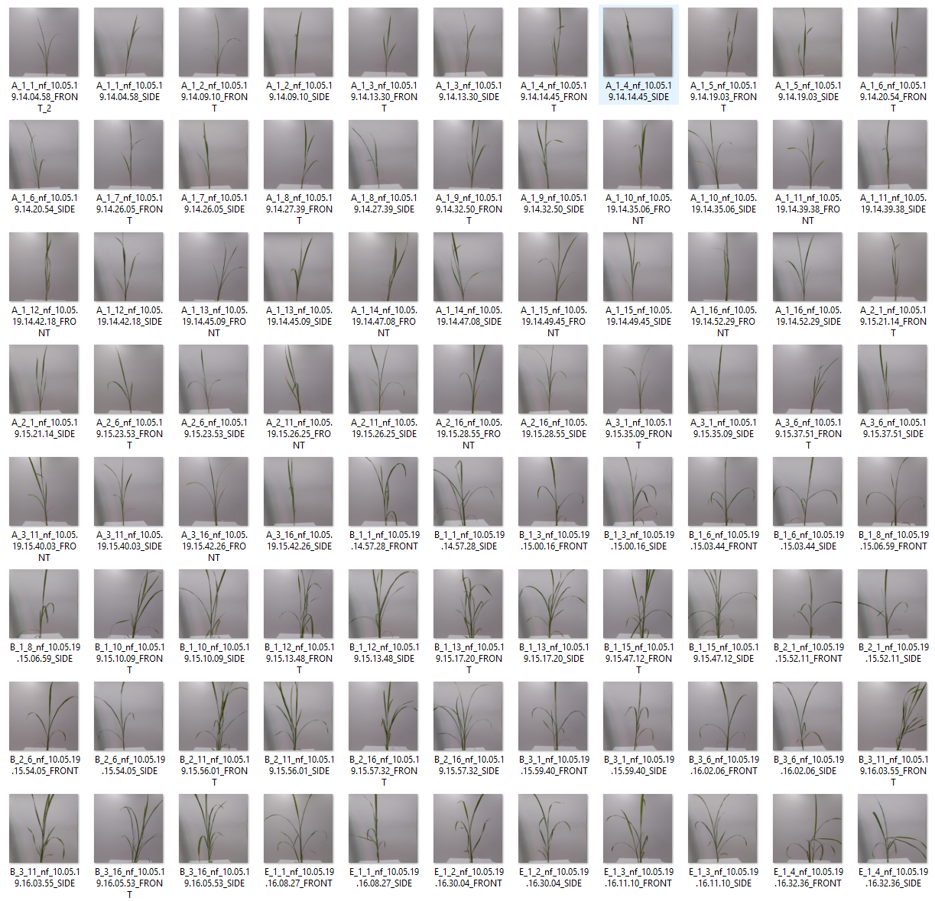
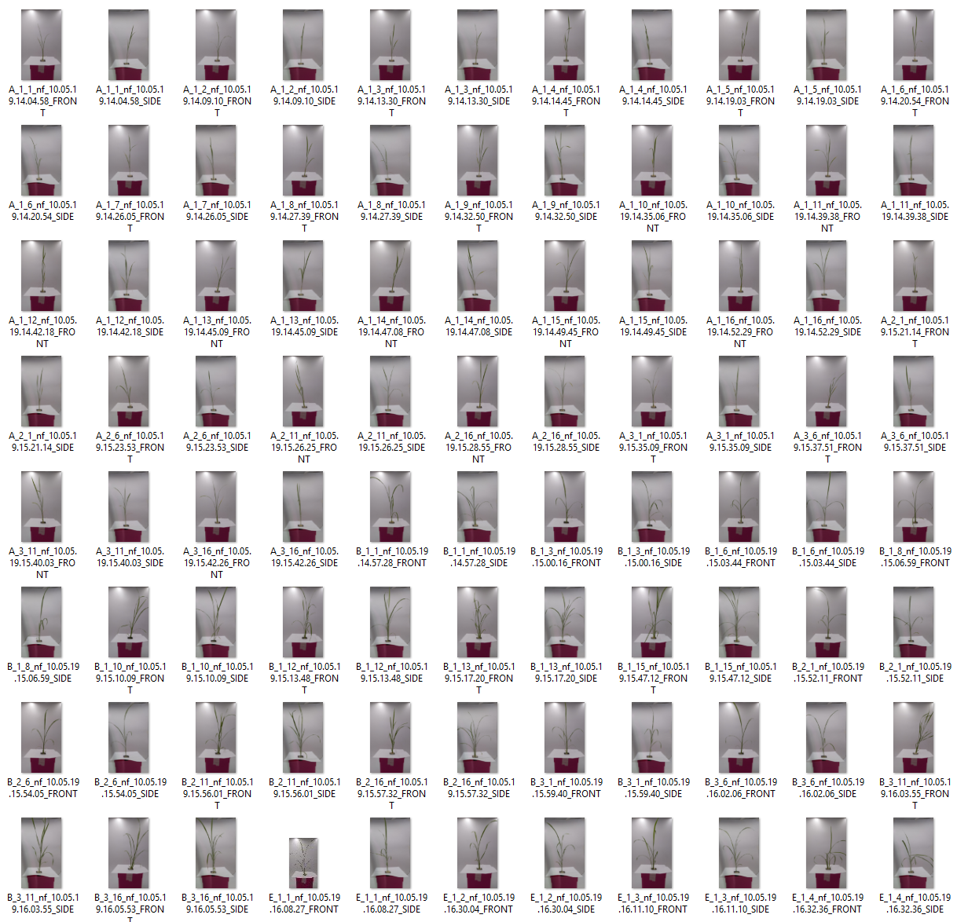
Thai rice Images
138 images of front and side views
Rice plants are feed with vary nutrient concentration
(0.25%, 5%, 25%, 50% and 100%)
720x720 Pixel images

Slide 19

mnist dataset
50,000 Training dataset 10,000 Validation dataset 10,000 Test dataset
THE MNIST DATABASE. (n.d.). Retrieved from http://yann.lecun.com/exdb/mnist/

Slide 20
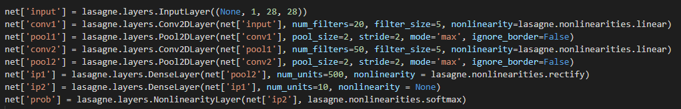
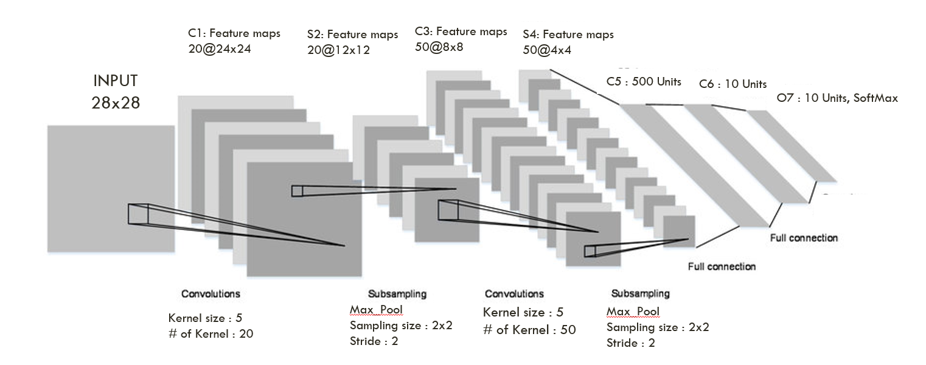
Lenet-5 cnn
Rizwan, M. (2018, September 30). LeNet-5 - A Classic CNN Architecture. Retrieved from https://engmrk.com/lenet-5-a-classic-cnn-architecture/

Slide 21
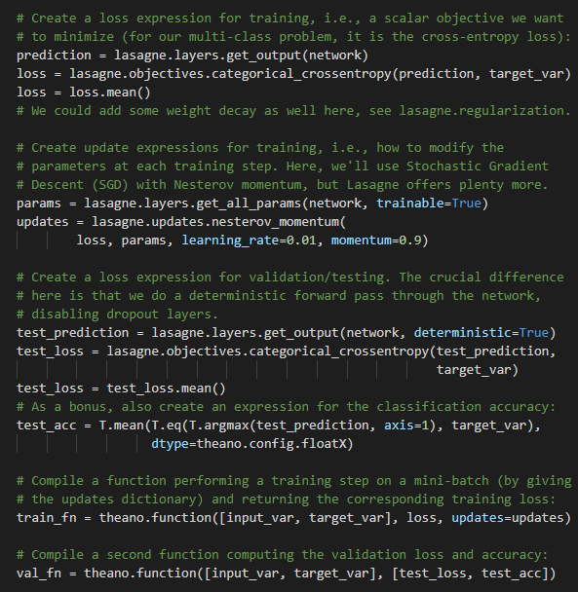
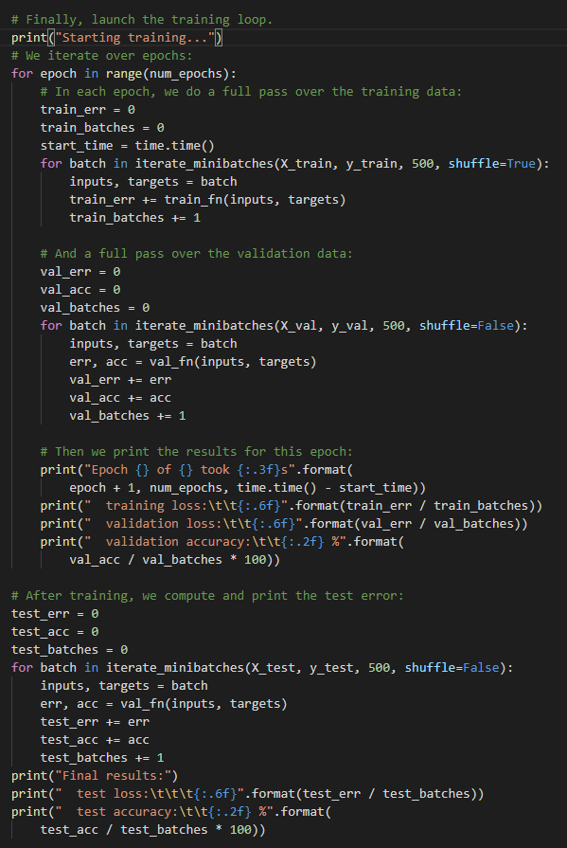
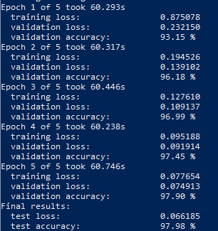
Train CNN Model with Mnist dataset on desktop computer
Training setup
Training, Validation, Testing
Result for 5 epochs

Slide 22
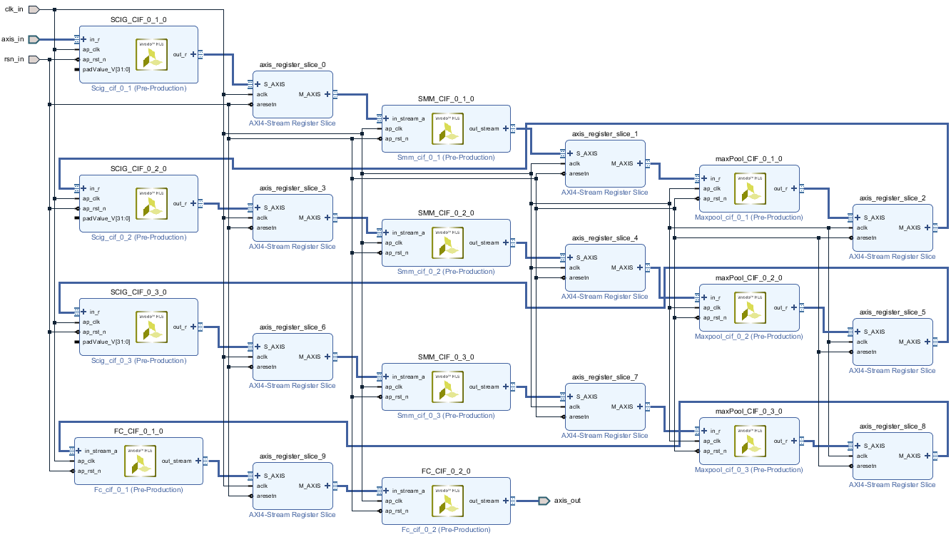
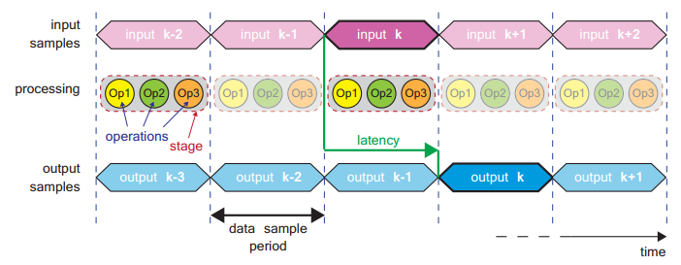
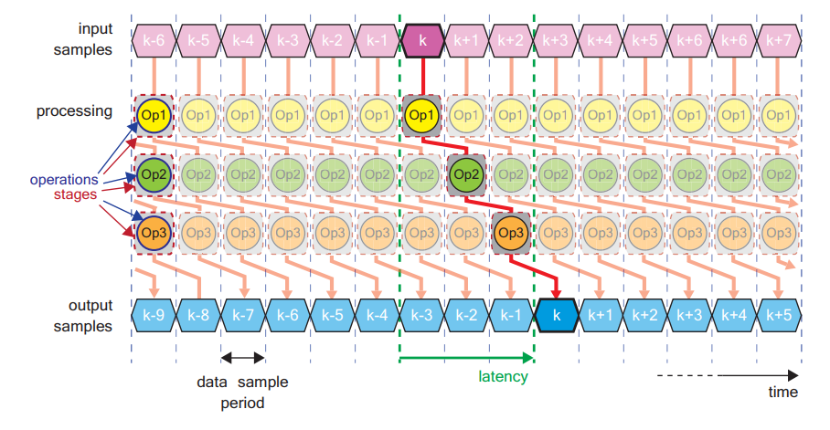
CNN Vivado ip design
The design is based on IP blocks of the CNN layer concatenating together to form the complete model. Each layer will be separated by the register according to the Pipeline design directive.
Crockett, L. H., Elliot, R. A., & Enderwitz, M. A. (2014). The Zynq Book Embedded Processing with the Arm Cortex-A9 on the Xilinx Zynq-7000 All Programmable Soc. Glasgow: Strathclyde Academic Media.

Slide 23
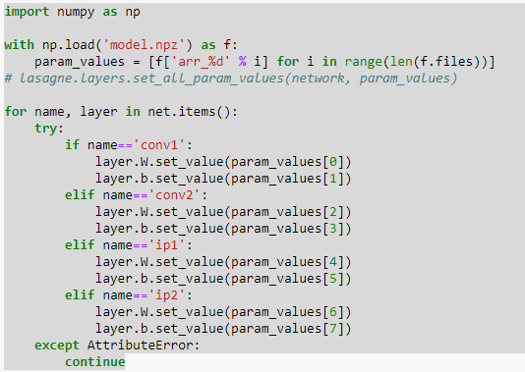
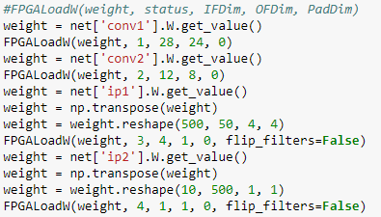
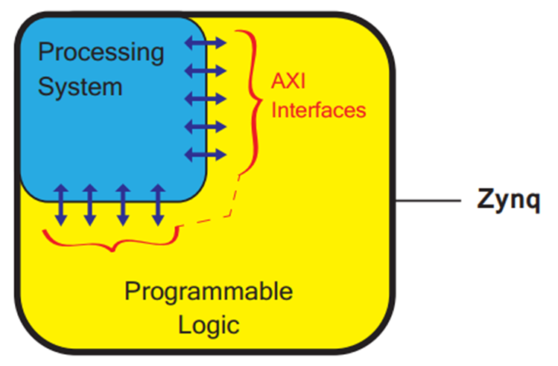
Setup model on pynq
Weights transfer from trained model on PC to CNN model on PYNQ
Load weights from CNN model on PS side to CNN model on PL side
Crockett, L. H., Elliot, R. A., & Enderwitz, M. A. (2014). The Zynq Book Embedded Processing with the Arm Cortex-A9 on the Xilinx Zynq-7000 All Programmable Soc. Glasgow: Strathclyde Academic Media.

Slide 24
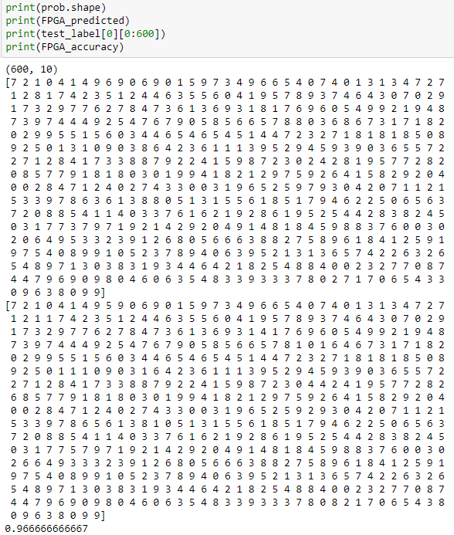
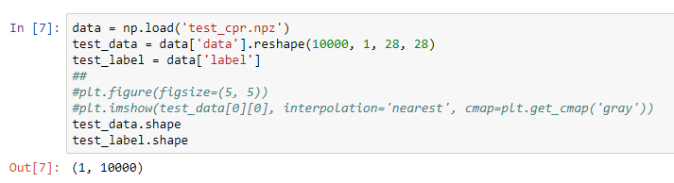
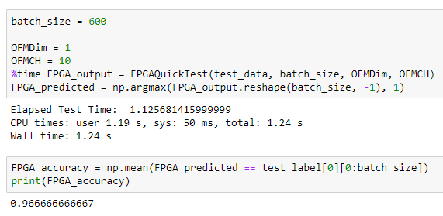
Continue
Predict and target label
Download test data to PYNQ
Run prediction on FPGA side CNN model

Slide 25
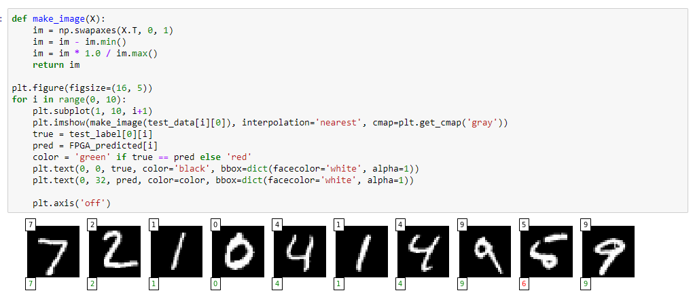
Printing Sample result

Slide 26
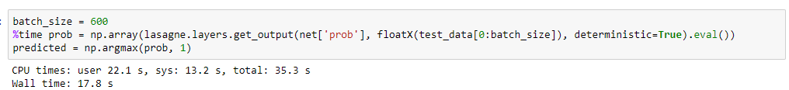
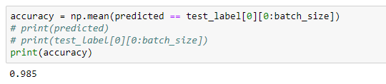
Running CNN on the same testing batch with arm CPU

Slide 27
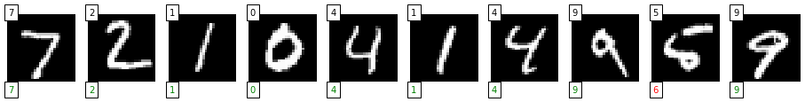
Result
Run on | Batch size | Accuracy | Processing time for prediction
Dual-core Cortex-A9 processor | 600 images | 98.5% | 17.8 s
FPGA | 600 images | 96.67% | 1.24 s
Training CNN model for stress detection in Thai rice plant has a very low testing accuracy.
The model need furthermore work on optimization and correction. The image dataset need also need a
pre-processing step in order to improve accuracy of the model.

